Slide 1

Project Title: PharmaPulse: GENAI Chatbot for Streamlined Drug Information
Team Members
Girish J R(211501028)
Jenish Praveen Kumar(211501036)
Mentor Name: Mr.U.kumaran
Department of Artificial Intelligence & Machine Learning
AI19711 – Phase I Project

Slide 2
Problem Statement
In the healthcare domain, accessing accurate and up-to-date drug information is a critical yet time-consuming task for healthcare providers, patients, and caregivers. The need for detailed guidance on prescriptions, safety alerts, and patient-specific advice often requires extensive searches across multiple sources. This delays decision-making, impacting the efficiency of healthcare delivery and patient safety. There is a pressing need for a solution that can streamline the extraction and presentation of relevant drug information in an easily understandable format, enabling quicker, more informed decisions and improving overall healthcare outcomes.

Slide 3
MOTIVATION
Simplify Access: Make it easy and quick for healthcare providers, patients, and caregivers to find detailed and accurate medication information.
Reduce Errors: Minimize the risk of medication mistakes by presenting clear and user-friendly information.
Improve Efficiency: Save time and enhance decision-making in healthcare by streamlining the retrieval of crucial drug information.
Enhance Patient Care: Support better treatment outcomes by ensuring timely and precise access to medication details.

Slide 4
Objectives
Develop a GENAI Chatbot: Create an AI-powered chatbot to extract and process medication information from drug websites.
To use NLP to retrieve information from the data
Present Information Clearly: Ensure the chatbot provides detailed, user-friendly medication details and safety alerts.
Enhance Accessibility: Enable quick and efficient access to essential drug information for healthcare providers, patients, and caregivers.
Reduce Medication Errors: Improve patient safety by minimizing the risk of medication mistakes through accurate and clear information.

Slide 5
Abstract
Our project focus on developing a GENAI-powered chatbot to streamline drug information retrieval for healthcare providers. The chatbot is designed to extract and process prescribing information, including dosage, administration methods, contraindications, and patient-specific advice such as interactions and precautions from drug labels. By leveraging natural language processing techniques, the chatbot will transform complex drug information into easily understandable responses. This tool aims to enhance clinical decision-making by providing healthcare professionals with rapid access to accurate and relevant drug data. Ultimately, the chatbot seeks to improve patient safety and optimize medication management through efficient information retrieval and presentation. By automating the process of extracting and interpreting drug information, the chatbot will free up clinicians' time, reduce medication errors, and facilitate informed decision-making. The development of this chatbot represents a significant step towards leveraging AI to improve healthcare delivery.

Slide 6
Feasibility Study
Objective | Feasibility | Challenges | Recommendations
Data preprocessing | High – NLP for extracting content from the given document | Building pipeline on large medical datasets can be computationally expensive. | Utilize GPU training platforms for data extraction and preprocessing.
Efficiently extract and structure information from the PDF for easy retrieval. | PDF parsing tools can accurately extract text,. | Handling any potential inconsistencies in the document's formatting, | Use advanced PDF parsing libraries and validate extracted data to ensure accuracy and consistency.
Question-Answer mapping | Given the structured nature of the content, creating a robust question-answer mapping system is feasible. | Dealing with ambiguous or poorly formulated user queries. | Implement NLU techniques to improve query interpretation and ensure relevant answer retrieval.
Personalized AI Suggestions | High - Existing NLP and RAG frameworks can be leveraged to create a functional chatbot. | Integrating these technologies seamlessly to provide real-time, contextually appropriate responses. | Utilize well-established frameworks LangChain, and fine-tune models specifically for medical content.

Slide 7
TECH STACK
Software Requirements:
Operating System: Windows 10 (for local development and testing).
Deep Learning Framework: PyTorch, NLP, LLM(for RAG).
Frontend: Html, CSS (for interactive user interface).
Backend: Flask.
Hardware Requirements:
High-Performance CPU: For general computation and model training.
GPU: NVIDIA RTX, AMD(essential for accelerating deep learning model training and inference).

Slide 8
Scope and Limitations
SCOPE
Medication Information Retrieval
Natural Language Processing
LIMITATIONS
Limitations of AI
Complexity of Information
Regulatory Compliance

Slide 9
Literature Review
Paper Title | Author & year | Methodology | Inference | limitations
Language Models are Few-Shot Learners | Brown, T., Mann, B., Ryder, N., et al., 2020 | GPT-3 model trained on large-scale datasets with few-shot learning capabilities. | Demonstrated versatility across a wide range of NLP tasks. | Requires high computational resources.
Clinical NLP for Extraction of Drug Information | Jiang, H., Liu, C., & Zhang, Y., 2022 | NLP models for identifying drug-related information from clinical text. | Improved accuracy in extracting drug entities from medical text. | Struggles with domain-specific ambiguity.
Applications of Artificial Intelligence and Chatbots in Medicine | Khan, M., Patel, S., & Roberts, J., 2020 | AI-driven chatbots designed for healthcare applications. | Enhanced patient engagement and medication adherence. | Lacks human empathy in patient interactions.
Overview of the TREC 2020 Precision Medicine Track | Roberts, C., Zhang, F., & Patel, S., 2020 | Precision medicine track analyzing clinical text for treatment recommendations. | Improved retrieval of treatment-related data for specific conditions. | Limited generalizability to rare diseases.
Leveraging Electronic Health Records for Pharmacovigilance | Zhang, X., Liu, J., & Zhao, L., 2020 | Machine learning models trained on EHR data for pharmacovigilance. | Enhanced detection of adverse drug reactions. | Privacy concerns with EHR data usage.

Slide 10
Paper Title | Author & year | Methodology | Inference | limitations
A Review of Drug Knowledge Representation for Medical Text Mining | Peng, Y., Zhang, J., & Luo, F., 2020 | Representation models for drug-related knowledge. | Improved structured representation for downstream medical tasks. | Lacks scalability for extensive drug datasets.
The Personalization of Conversational Agents in Healthcare | Kocaballi, A., Laranjo, L., & Coiera, E., 2020 | Personalized conversational agents for healthcare settings. | Improved user engagement and patient satisfaction. | Requires extensive personalization data.
A Patient-Centered Health Chatbot for Medication Adherence | Lin, Y., Chou, W., & Tan, R., 2020 | Chatbot designed to improve medication adherence. | Encouraged consistent medication use among patients. | Limited support for complex medical queries.
The Design and Implementation of XiaoIce, an Empathetic Social Chatbot | Zhou, L., Wang, Y., & Zhang, H., 2020 | Empathetic conversational model for social interactions. | Successfully created a more natural and empathetic chatbot. | Focused on general-purpose interactions.
An Overview of Chatbot Technology | Adamopoulou, E., & Moussiades, L., 2020 | Comprehensive review of chatbot architectures. | Provided insights into advancements in chatbot development. | Limited focus on healthcare-specific applications.

Slide 11
Paper Title | Author & year | Methodology | Inference | limitations
RoBERTa: A Robustly Optimized BERT Pretraining Approach | Liu, Y., Ott, M., Goyal, N., et al., 2019 | Robust pretraining of BERT with dynamic masking. | Outperformed BERT on multiple NLP benchmarks. | Computationally intensive.
Language Models are Unsupervised Multitask Learners | Radford, A., Wu, J., & Amodei, D., 2019 | Autoregressive model pre-trained on large datasets. | Demonstrated strong few-shot learning capabilities. | Can generate biased outputs.
BERT: Pre-training of Deep Bidirectional Transformers for Language Understanding | Devlin, J., Chang, M., Lee, K., & Toutanova, K., 2019 | Masked language modeling with bidirectional transformers. | Achieved state-of-the-art results in NLP tasks. | Computationally expensive.
End-to-End Deep Learning for Clinical Information Extraction | Lee, J., Yoon, W., & Kim, S., 2018 | End-to-end deep learning approach for medical text. | Improved accuracy in clinical information extraction. | Limited interpretability of the model.
Conversational Agents in Healthcare: Scoping Review and Conceptual Analysis | Laranjo, L., Dunn, A. G., & Tong, H. L., 2018 | Scoping review of conversational agents in healthcare. | Highlighted potential of chatbots for patient engagement. | Challenges in maintaining data privacy.

Slide 12
Paper Title | Author & year | Methodology | Inference | limitations
Attention is All You Need | Vaswani, A., Shazeer, N., Parmar, N., et al., 2017 | Transformer architecture with self-attention. | Outperformed RNNs; enabled parallelization. | Requires large data and computing power.
A Survey on Chatbot Implementation in Customer Service Industry | Chen, Y., Zhang, L., & Li, J., 2017 | Survey on chatbot technologies in customer service. | Provided insights into benefits and challenges of chatbots. | Focused on customer service, not healthcare.
Building End-to-End Dialogue Systems Using Generative Hierarchical Neural Network Models | Serban, I. V., Lowe, R., & Charlin, L., 2016 | Hierarchical generative models for dialogue systems. | Enhanced end-to-end dialogue systems' performance. | Struggles with long-term context retention.
Relational Agents in Clinical Practice | Bickmore, T., Pfeifer, L., & Jack, B., 2015 | Development of relational agents for clinical use. | Improved patient-provider communication. | Limited support for non-English languages.
A Review of Approaches to Identify Patient-Level Information in Unstructured Clinical Text | Shivade, C., Raghavan, P., & Fosler-Lussier, E., 2014 | Approaches for identifying patient-level data in text. | Improved patient-specific information extraction. | Difficulty handling noisy clinical text.

Slide 13
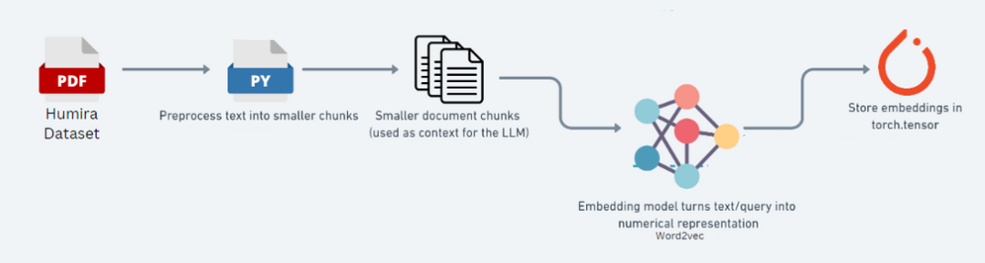
Architectural Design

Slide 14
LIST OF MODULES
Data preprocessing with NLP
Embedding generation and storing
Query processing and response generation

Slide 15
1.NLP PIPELINE
1) Document Ingestion
The initial stage involves collecting and ingesting data, specifically PDFs or other text sources that contain detailed information about Humira. This dataset includes critical information like dosing instructions, contraindications, side effects, dietary recommendations, and other patient-specific guidance.
2) Text Preprocessing
To make the data manageable and ready for NLP processing, the raw text is preprocessed using a series of NLP techniques. The preprocessing steps include:
Sentence Segmentation: The document is divided into individual sentences, enabling better granularity when analyzing and embedding the content.
Word Tokenization: Each sentence is split into individual words or tokens, which allows for more detailed processing of text elements.
Stop Words Removal: Common words (like "the," "is," and "and") that do not add value to the semantic meaning are removed to reduce noise in the data.

Slide 16
1.NLP PIPELINE
Stemming and Lemmatization: Words are reduced to their root forms, ensuring that different variations of a word (e.g., "prescribing" and "prescribe") are treated as a single entity, improving the model’s consistency in understanding terms
Dependency Parsing: The grammatical relationships between words are analyzed, which helps the model understand the context and structure of the information, essential for preserving the meaning in medical text.
3) Chunking of Text Data
The preprocessed data is then broken down into smaller, context-specific chunks. These chunks are designed to capture individual pieces of information that can act as standalone context when processed by the language model. This step is crucial for maintaining information relevance and making retrieval more efficient in subsequent phases.
Each chunk represents a semantically meaningful segment, such as a dosage guideline or a specific patient precaution, allowing the model to retrieve answers based on context rather than the entire document.

Slide 17
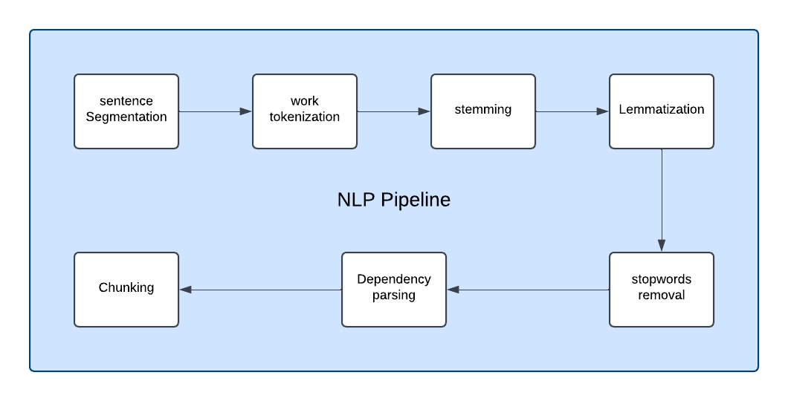
1.DATA PREPROCESSING - NLP PIPELINE

Slide 18
2.Embedding generation and Storage
Embedding Generation
Once the data is divided into chunks, each chunk is converted into a numerical representation, known as an embedding. Using an embedding model like Word2Vec or a similar transformer-based embedding model, these text chunks are transformed into high-dimensional vectors that capture the semantic meaning of the information. In this project, embeddings are generated and stored in PyTorch tensors, ensuring that they are ready for fast and efficient retrieval during the chatbot's response generation.
Embedding Storage in PyTorch Tensors
After generating embeddings, they are stored as tensors using PyTorch. This approach allows for efficient indexing and retrieval, facilitating quick access to relevant information during real-time queries in the chatbot. By using tensor-based storage, the model can handle large amounts of text data with high-speed operations, which is essential for the seamless performance of the chatbot.

Slide 19
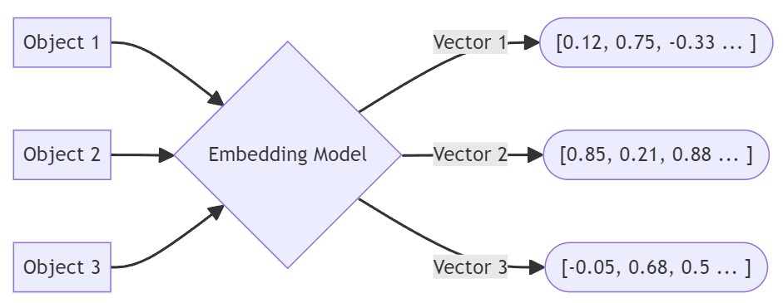
2.Embedding generation and Storage

Slide 20
2.Embedding generation and Storage
Why Convert Data into Embeddings?
Semantic Representation of Data
Converting data into embeddings allows the system to represent text, images, or any other data in a high-dimensional vector space.
Efficient Similarity Matching Embeddings make it possible to compute similarity scores between queries and stored data.
Handles Complex Data Relationships Embeddings allow the system to understand the context and relationships between words or phrases, improving accuracy.
Multimodal Capabilities Embeddings unify different types of data (text, images, audio, etc.) into a single mathematical format, enabling systems to work across multiple data types seamlessly.

Slide 21
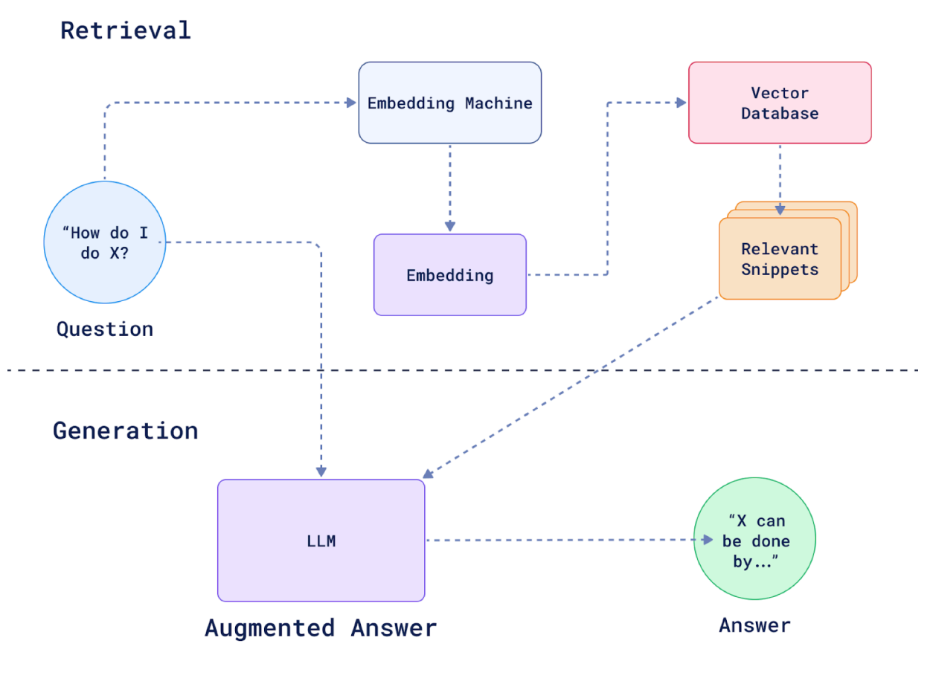
3.QUERY PROCESSING AND RESPONSE GENERATION

Slide 22
3.QUERY PROCESSING AND RESPONSE GENERATION
Query Understanding The process begins when the user inputs a query, such as “How do I do X?” The query is transformed into a numerical representation (embedding) using an Embedding Machine.
Vector Embedding Generation The embedding represents the query in a vector space, making it easier to find related knowledge snippets. It acts as the foundation for matching the query with stored information.
Vector Database Search A Vector Database is pre-loaded with embeddings of relevant documents or knowledge snippets. Using similarity-based search algorithms, the database identifies the most relevant snippets that align with the query.
Snippet Retrieval The retrieved snippets are the most contextually relevant pieces of information, extracted from the vector database. These snippets provide factual grounding for generating an accurate response.

Slide 23
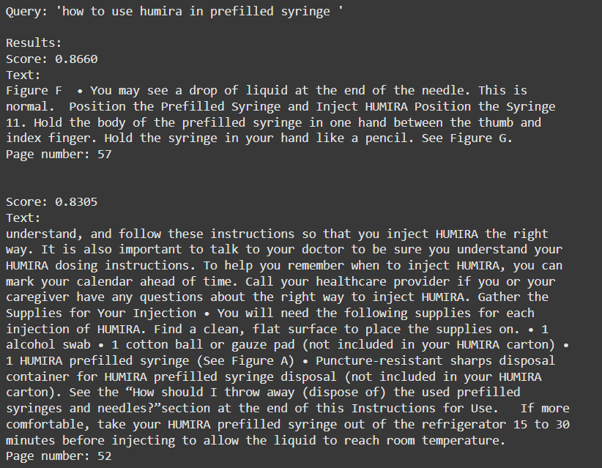
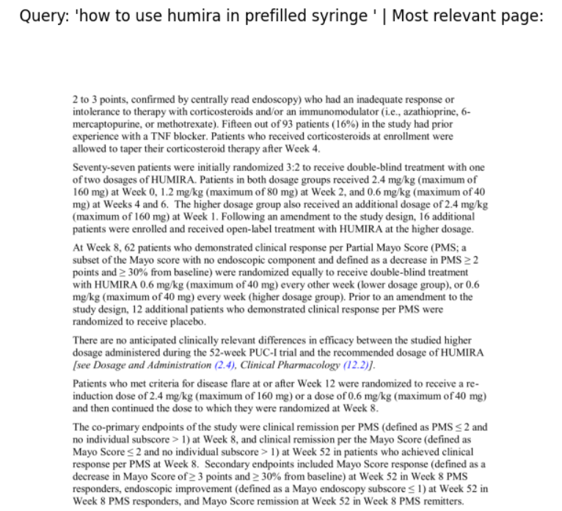
ReSULT

Slide 24
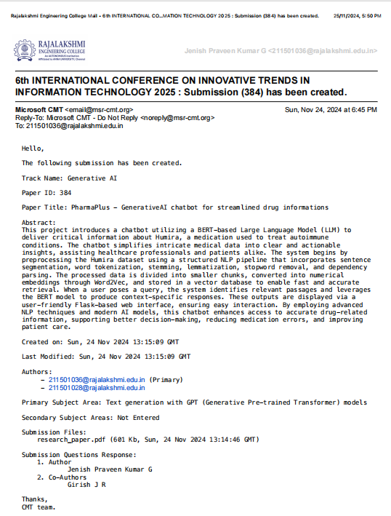
PATENT/ publication/competition status
The Paper is submitted in the 6th Internation Conference by Mr. U. Kumaran, J.R. Girish, G. Jenish Praveen Kumar. PharmaPulse: GENAI Chatbot for Streamlined Drug Information on INNOVATIVE TRENDS IN INFORMATION TECHNOLOGY 2025:

Slide 25
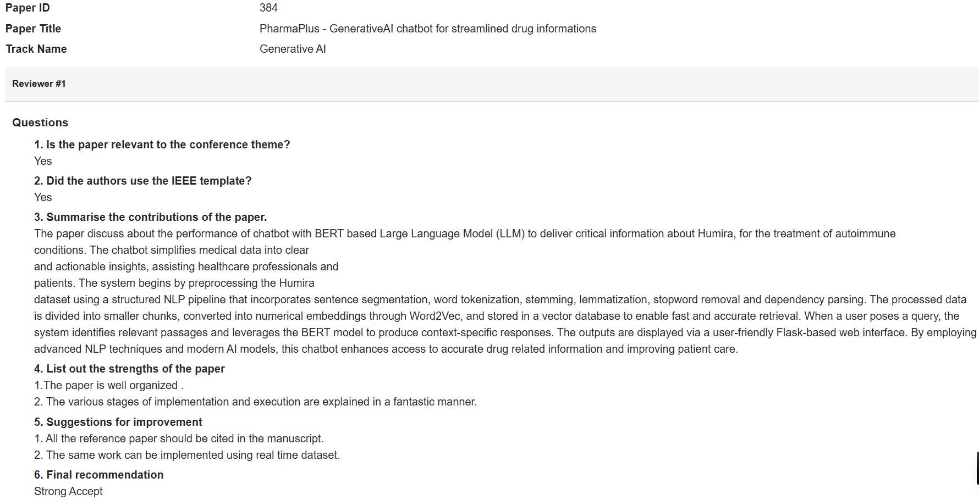
PATENT/ publication/competition status
The 6th International Conference on Innovative Trends in Information Technology 2025 has approved it.

Slide 26
References
[1] Brown, T., Mann, B., Ryder, N., et al. (2020). Language Models are Few-Shot Learners. In Advances in Neural Information Processing Systems.
[2] Jiang, H., Liu, C., & Zhang, Y. (2022). Clinical NLP for Extraction of Drug Information. Journal of Medical Informatics.
[3] Khan, M., Patel, S., & Roberts, J. (2020). Applications of Artificial Intelligence and Chatbots in Medicine. Health Informatics Review.
[4] Roberts, C., Zhang, F., & Patel, S. (2020). Overview of the TREC 2020 Precision Medicine Track. TREC Proceedings.
[5] Zhang, X., Liu, J., & Zhao, L. (2020). Leveraging Electronic Health Records for Pharmacovigilance. IEEE Transactions on Medical Data Analysis.
[6] Peng, Y., Zhang, J., & Luo, F. (2020). A Review of Drug Knowledge Representation for Medical Text Mining. Artificial Intelligence in Medicine Review.
7] Kocaballi, A., Laranjo, L., & Coiera, E. (2020). The Personalization of Conversational Agents in Healthcare. Journal of Patient-Centered Computing.
[8] Lin, Y., Chou, W., & Tan, R. (2020). A Patient-Centered Health Chatbot for Medication Adherence. In Proceedings of the ACM Health Informatics Workshop.
[9] Zhou, L., Wang, Y., & Zhang, H. (2020). The Design and Implementation of XiaoIce, an Empathetic Social Chatbot. ACM Transactions on Interactive Intelligent Systems.
[10] Adamopoulou, E., & Moussiades, L. (2020). An Overview of Chatbot Technology. In international conference on AI

Slide 27
References
[11] Liu, Y., Ott, M., Goyal, N., et al. (2019). RoBERTa: A Robustly Optimized BERT Pretraining Approach.
[12] Radford, A., Wu, J., & Amodei, D. (2019). Language Models are Unsupervised Multitask Learners. OpenAI Technical Report.
[13] Devlin, J., Chang, M., Lee, K., & Toutanova, K. (2019). BERT: Pre-training of Deep Bidirectional Transformers for Language Understanding. In Proceedings of the NAACL Conference.
[14] Lee, J., Yoon, W., & Kim, S. (2018). End-to-End Deep Learning for Clinical Information Extraction. In Proceedings of the Clinical NLP Workshop.
[15] Laranjo, L., Dunn, A. G., & Tong, H. L. (2018). Conversational Agents in Healthcare: Scoping Review and Conceptual Analysis. Journal of Medical Internet Research.
[16] Vaswani, A., Shazeer, N., Parmar, N., et al. (2017). Attention is All You Need. In.Advances in Neural Information Processing Systems.
[17] Chen, Y., Zhang, L., & Li, J. (2017). A Survey on Chatbot Implementation in Customer Service Industry. In Proceedings the IEEE International Conference on Business Automation.
[18] Serban, I. V., Lowe, R., & Charlin, L. (2016). Building End-to-End Dialogue Systems Using Generative Hierarchical Neural Network Models. In Proceedings of the AAAI Conference.
[19] Bickmore, T., Pfeifer, L., & Jack, B. (2015). Relational Agents in Clinical Practice. Patient Education and Counseling.
[20] Shivade, C., Raghavan, P., & Fosler-Lussier, E. (2014). A Review of Approaches to Identify Patient-Level Information in Unstructured Clinical Text. Journal of Biomedical Informatics.

Slide 28
Thank you
Girish J R (211501028)
Jenish Praveen Kumar G (211501036)

